Slide 1
Hire Loop
Kevin Dong, Rishi Chawla, Avi Maheshwari, Eshaan Salvi, Katelyn Doucette, Charan Sama

Slide 2
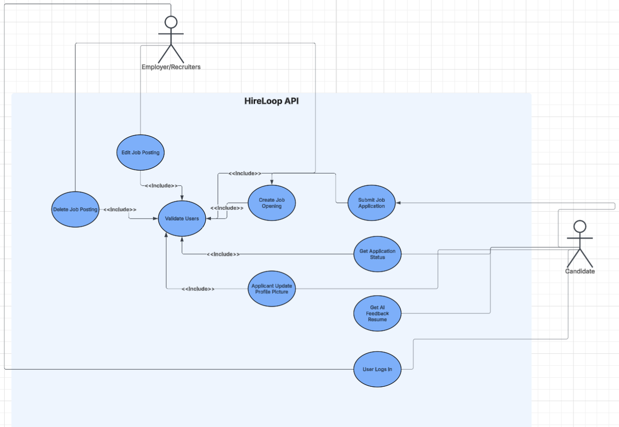
What is Hire Loop?
Job searching and matching service, designed to connect prospective employees and employers
Candidates can:
Search for jobs
Track positions
Apply to postings
Employers can:
Create postings
View applications

Slide 3
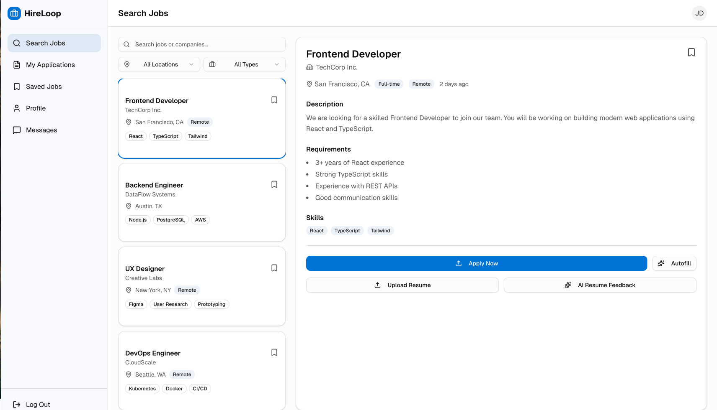
Features
Comprehensive job search and easy application process
Candidates can search and filter jobs
Ability for employers to contact candidates of interest
Employers can review and message candidates of interest
Matching algorithm to find the best fit job
System scores jobs against applicants skills, education, and experience

Slide 4
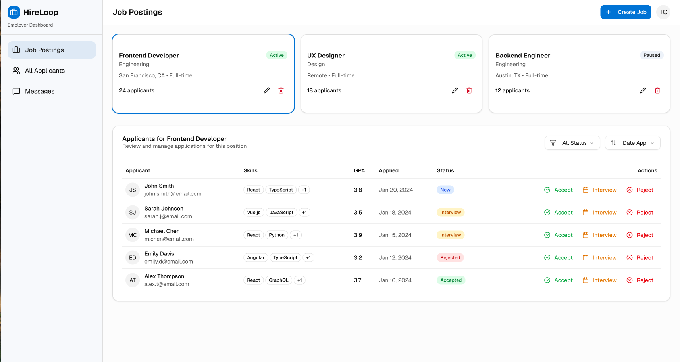
Features
AI feedback on resumes for applicants
Uploaded resumes receive feedback from AI
Application tracking
Candidates can track applications, as well as employers
Profile + Resume Tools
Candidates can manage profile details and reuse saved information
Saved Jobs
Candidates can save jobs to apply for later

Slide 5
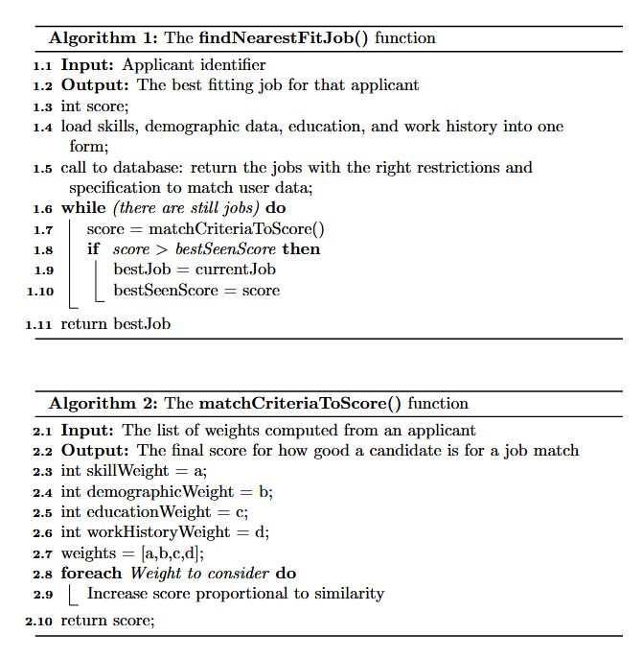
Design Challenges
The matching algorithm
Determining what makes a “good” match between candidate and job
Balancing skill vs job requirements, experience levels, and user preferences
Avoiding overly simplistic matching
Connection between databases and frontend UI
Ensuring real time communication between UI and database
Handling asynchronous data

Slide 6
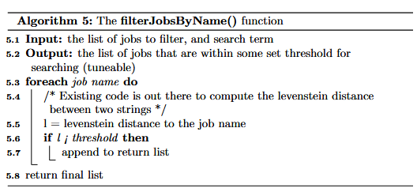
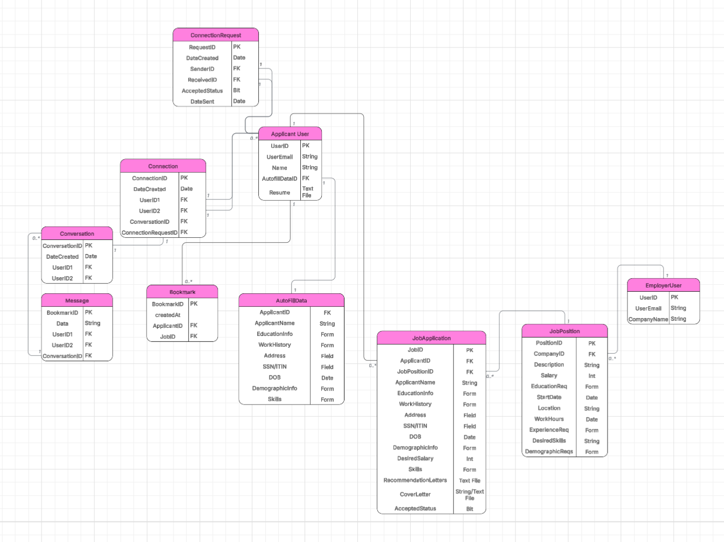
Design Challenges
Data structure and scalability
Designing schemas for users, job postings, and applications
Need specialized algorithms (levenshtein distance)
User experience
Making job search intuitive and fast
Making sure users can use the site freely with no problems

Slide 7

Team Organization Challenges and Strategies
Divided the project into sub teams that focus on specific tasks
Front-end
Back-end/API layer
Database
Utilized various team organization technologies and strategies
Git (via GitHub)
Google Workspace Technologies
AGILE
Front-end
Back-end
Database

Slide 8
Design Solutions
Outside understanding
Started with a rule based scoring system
Normalized scores to rank candidates/jobs effectively
Creating an API for communication
Built a REST style API for job retrieval, application submissions, and user data
Database design optimization
Used IDs and relationships to reduce redundancy
Ensured efficient queries for search and filtering
Asynchronous data handling
Implemented fetch/async calls for dynamic UI updates
Prevented UI freezing and improved responsiveness

Slide 9
Lessons Learned
Importance of system design
Early design decisions greatly impact scalability
Clean architecture makes debugging easier
Iterative development
Initial implementations were too simple
Improved gradually through testing and feedback
Real world complexity
Matching users to jobs is more complex than expected
Edge cases matter a lot
Backend and frontend separation matters
Keeping logic separate improved maintainability
Easier to update backend without breaking frontend
Team collaboration
Dividing responsibilities improved efficiency
Communication was critical for integration

Slide 10
Thank you!
Questions?

